Slide 1

API Authorization
WSO2 Identity Server Fundamentals

Slide 2
What is API Authorization?
Process of controlling access to APIs based on the identity and permissions of the requesting user or application.

Slide 3
Why securing APIs matter?
Protect sensitive data
Preventing unauthorized access
Ensure compliance with security standards and regulations

Slide 4
Key Concepts

Slide 5
Key Concepts
API resources:
Represent the endpoints or functionalities exposed by an API.
Scopes:
Known as permissions. Scopes represent an action an application can perform on behalf of a user.

Slide 6
Types of API Authorization
Role-Based Access Control (RBAC)
Attribute-Based Access Control (ABAC)

Slide 7
RBAC for API resources

Slide 8
Role Based Access Control (RBAC)
An access control model where access to resources is based on the roles assigned to users or applications.
Implement granular access control to specific API endpoints or functionalities.
Users or applications assigned roles based on their job responsibilities or required permissions.
Only users or applications with appropriate roles can access.

Slide 9
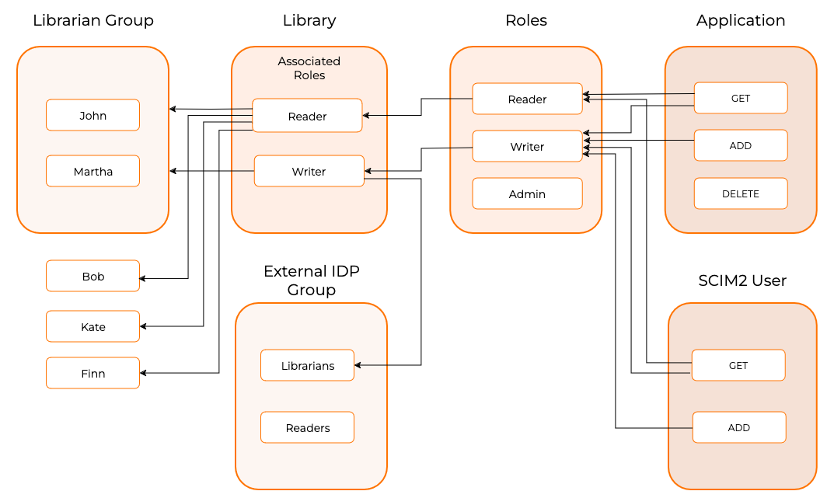
How it works?

Slide 10
Quick Recap

Slide 11

Overview of API authorization
Benefits of securing APIs
Types of API authorization
Role Based Access Control (RBAC)
What you learnt

Slide 12



Any Questions ?
Reach us through the following channels
iam-dev@wso2.org
https://stackoverflow.com/questions/tagged/wso2-identity-server
https://discord.com/invite/Xa5VubmThw

Slide 13
Thank you!
Notes:
Acknowledge that it’s been a lot of changes within the team
Thank you for your taking onboard the feedback and being open to change.
A lot of work , a lot of learning, sometimes feeling twice the exhaustion
But also hopefully seeing what I see, which is: better ways of working, more innovation in our approach, more business acumen, more effective reactivity , more ahead of the game. Because that’s where marketing needs to be.
All this in a context where it’s also been a lot of changes for WSO2.
And from this standpoint I wanted to remind you of what Sanjiva said about you owning the culture

